Slide 1
Software Challenges and Success Rates

Slide 2
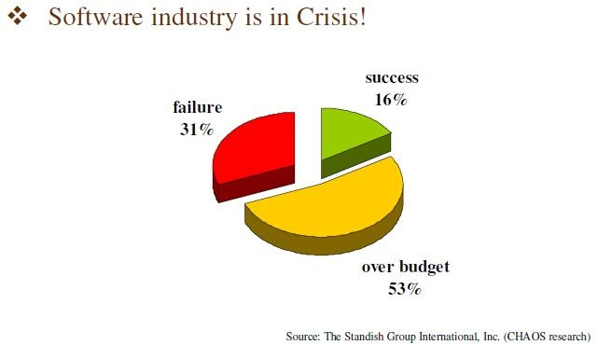
Evolving Role of Software

Slide 3
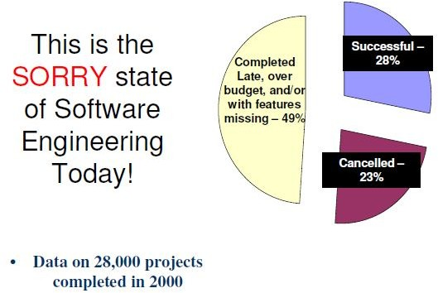
Evolving Role of Software…

Slide 4
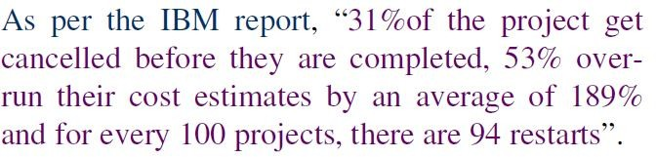
IBM Data Compilation (2001)

Slide 5
IT Project Failures 2019
IT projects are notoriously difficult to manage. A survey published in HBR found that the average IT project overran its budget by 27%. Moreover, at least one in six IT projects turns into a “black swan” with a cost overrun of 200% and a schedule overrun of 70%. (HBR)
Poorly training project managers, attempting too many projects, and a lack of project funding are the top three project management challenges in Wellingtone’s survey. (Wellingtone)
A PwC study of over 10,640 projects found that օnly 2.5% of companies complete their projects 100% successfully. The rest either failed to meet some of their original targets or missed the original budget or deadlines. These failures extract a heavy cost — failed IT projects alone cost the United States $50-$150B in lost revenue and productivity. (Gallup)

Slide 6




Evolving Role of Software…
Managers and Technical Persons are asked:
Why does it take so long to get the program finished?
Why cannot we find all errors before release?
Why are costs so high?
Why do we have difficulty in measuring progress of software development ?

Slide 7


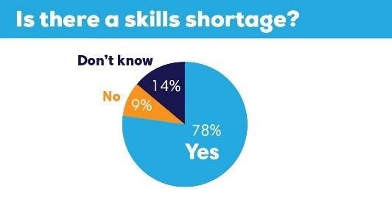

Factors Contributing to Software Crisis
Large Problems
Lack of adequate training in software
Increasing skill shortage
Low productivity improvements

Slide 8

Some Software Failures
https://www.youtube.com/watch?v=EMVBLg2MrLs

Slide 9
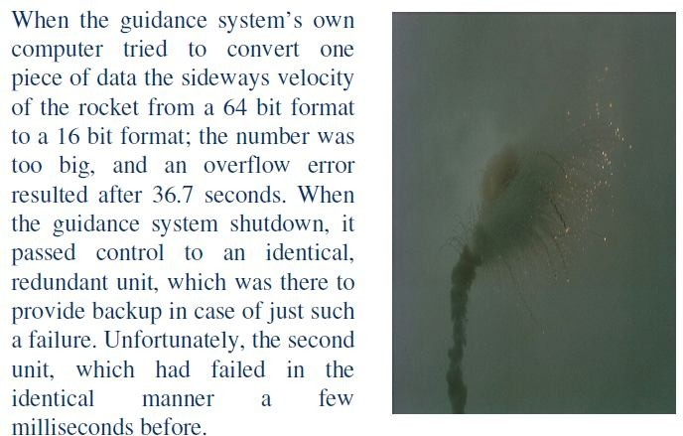
Some Software Failures…

Slide 10
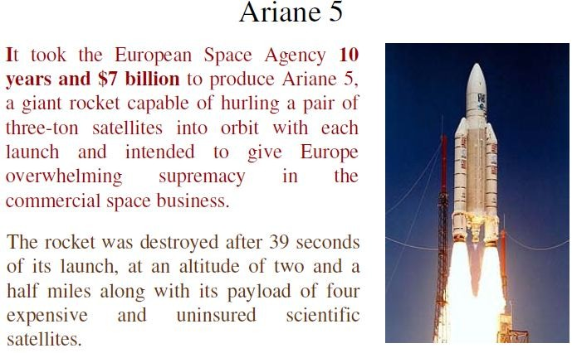
Some Software Failures

Slide 11
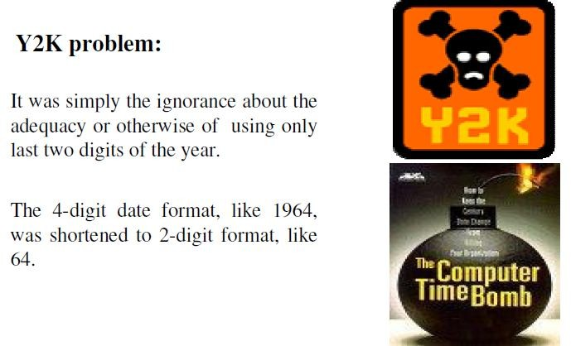
Some Software Failures…

Slide 12
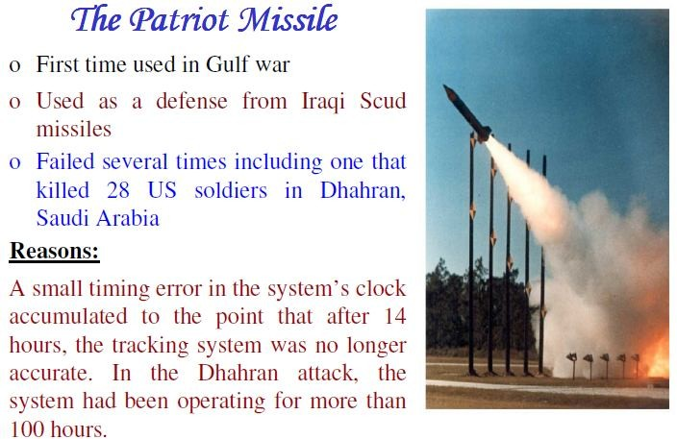
Some Software Failures…

Slide 13
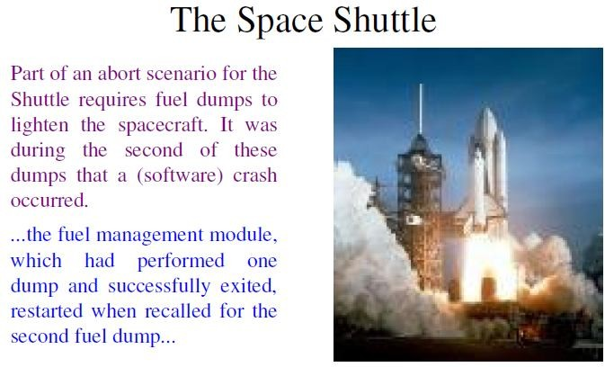
Some Software Failures…

Slide 14
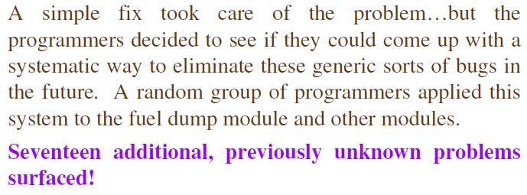
Some Software Failures…

Slide 15
Some Software Failures…
Financial Software
Many companies have experienced failures in their accounting system due to faults in the software itself. The failures range from producing the wrong information to the whole system crashing.

Slide 16
Some Software Failures…
Windows XP
Microsoft released Windows XP on October 25, 2001.
On the same day company posted 18 MB of compatibility patches on the website for bug fixes, compatibility updates, and enhancements.
Two patches fixed important security holes.

Slide 17
The Worst Computer Bugs in History: Race conditions in Therac-25
https://www.youtube.com/watch?v=uEvu2PlDhO0

Slide 18
What is Software?
The product that software professionals build and then support over the long term.
Software encompasses:
Instructions (computer programs) that when executed provide desired features, function and performance.
Data Structures that enable the programs to adequately store and manipulate information and
Documentation that describes the operation and use of the programs.

Slide 19
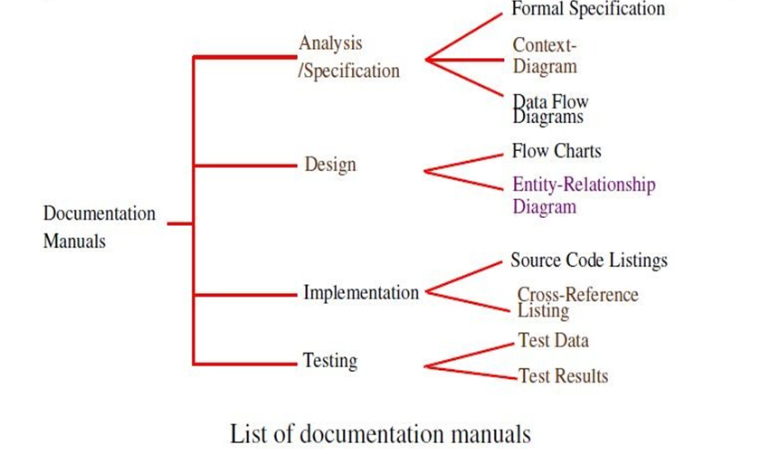
Documentation consists of different types of manuals are

Slide 20
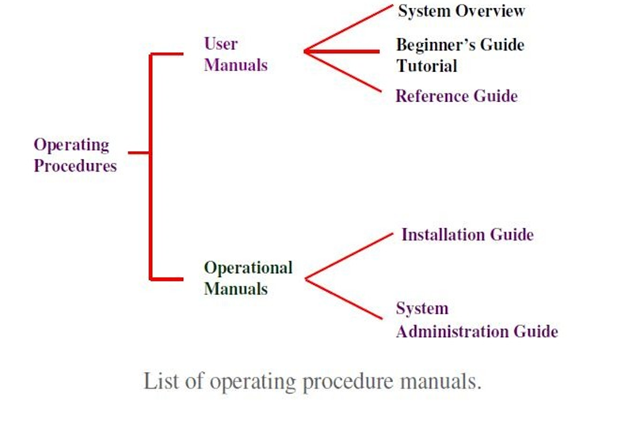
Documentation consists of different types of manuals are

